Slide 1

Predicting CO2 Emissions of Vehicles Using Real-Time Telematics Data
Data 602 Project Presentation-GROUP 2
Professor : Masoud Soroush
Presented By:
Akhilesh Akoju
Kianoush Ramezani Shabolaghi
Lokesh Reddy Kuppireddy
Sai Akhil Sadula
Suraj Hanumanthapura Chandra

Slide 2
Introduction
The primary aim is to analyze and predict CO2 emissions from various vehicles using the 'Car Fuel & Emissions 2000-2013' dataset.
Leveraging vehicle data to predict CO2 emissions, aiming to contribute to the development of greener transportation options.
Explore patterns and relationships to understand the factors influencing vehicle emissions, contributing to better environmental management.
Apply machine learning techniques to forecast emissions, aiming to enhance environmental planning.

Slide 3
Objectives
Develop machine learning model that accurately predicts CO2 emissions based on vehicle data.
Identify key factors that significantly influence vehicle emissions.
Determine how engine capacity, transmission type, and fuel type correlate with a vehicle's fuel efficiency.
Quantify the influence of transmission type on fuel efficiency through predictive modeling.

Slide 4
Objectives
Develop a predictive model for vehicle noise levels based on engine capacity, fuel type, and transmission type.
Exploring the relationship between engine capacity and CO emissions and establish a predictive model for the same.
Determine how engine capacity, transmission type, and fuel type correlate with a vehicle's fuel efficiency.
Analyzing if certain manufacturers and models have better emission standards.

Slide 5
Dataset Overview
Data source:
https://data.world/amercader/car-fuel-emissions-2000-2013
The dataset encompasses diverse vehicle specifications, including emissions (CO2, NOx, CO) and noise levels, linked to engine size, fuel type, and compliance standards.
Serves as a foundation for developing machine learning models to predict emissions and fuel efficiency, vital for sustainable environmental strategies.
Assists in understanding how different vehicle specifications align with emission standards, offering data-driven support for policymaking.

Slide 6
Columns Description
file: Indicates the data file from which the record is sourced.
year: The year in which the vehicle model was manufactured or released .
manufacturer: The brand or company that produced the vehicle.
model: The specific name or designation given to a vehicle by the manufacturer.
description: Provides additional details about the vehicle, which may include specific features, engine size, or special edition names.
euro_standard: European emission standards compliance level of the vehicle.
tax_band: A classification used to determine the vehicle tax rate, often based on CO2 emissions levels.
transmission: Specifies the type of gearbox in the vehicle, such as manual or automatic, along with the number of gears.

Slide 7
transmission_type: Categorizes the transmission into broader types, such as manual, automatic, or semi-automatic.
engine_capacity: The volume of the engine's cylinders, usually measured in cubic centimeters (cc) or liters, which is indicative of engine size.
fuel_type: The type of fuel the vehicle uses, such as petrol, diesel, electric, or hybrid.
urban_metric: Fuel efficiency in urban environments with frequent stops and starts, measured in liters per 100 kilometers.
extra_urban_metric: Fuel efficiency under steady-speed conditions, such as highways, measured in liters per 100 kilometers.
combined_metric: An average of urban and extra-urban fuel efficiency, providing a general measure of fuel consumption in liters per 100 kilometers.
urban_imperial: Fuel efficiency in urban environments, measured in miles per gallon, using the imperial system.
extra_urban_imperial: Highway fuel efficiency, measured in miles per gallon in the imperial system.

Slide 8
combined_imperial: The average fuel efficiency combining urban and extra-urban conditions, measured in imperial miles per gallon.
noise_level: The amount of noise the vehicle produces during operation, measured in decibels (dB), which is important for environmental noise pollution assessments.
co2: The amount of carbon dioxide emissions the vehicle produces, a key factor in global warming, usually measured in grams per kilometer (g/km).
thc_emissions: Total hydrocarbon emissions from the vehicle, which contribute to smog and are measured in grams per kilometer (g/km).
co_emissions: Carbon monoxide emissions from the vehicle, an odorless gas that can be harmful or fatal in high concentrations, measured in grams per kilometer (g/km).
nox_emissions: Nitrogen oxides emissions from the vehicle, which contribute to air pollution and acid rain, measured in grams per kilometer (g/km).

Slide 9
thc_nox_emissions: Combined emissions of total hydrocarbons and nitrogen oxides, which are collectively regulated due to their environmental impact.
particulates_emissions: This column measures the particulate matter (PM) emissions from the vehicle, which are tiny particles that can penetrate the lungs and cause health issues. Particulate emissions are of particular concern for diesel engines and are typically measured in grams per kilometer (g/km).
fuel_cost_12000_miles: : Estimated cost of fuel for traveling 12,000 miles, an indicator of the vehicle's long-term fuel economy.
fuel_cost_6000_miles: Estimated cost of fuel for traveling 6,000 miles, useful for short-term budgeting of fuel expenses.
standard_12_months: Likely refers to the standard cost of vehicle taxation or registration for a 12-month period.
standard_6_months: Similar to the above but for a 6-month period, possibly providing a shorter-term cost option for vehicle taxation or registration.

Slide 10
first_year_12_months: Costs associated with the first year of vehicle ownership, which may include higher rates of taxation or additional fees.
first_year_6_months: The cost for the first 6 months of owning the vehicle, which might also include initial taxes or fees that are specific to new vehicles.
date_of_change: Records the date when any changes were made to the vehicle's specifications or to the data entry, which can be important for tracking revisions or updates in the dataset.

Slide 11
Data Preprocessing
Initially, the dataset contains 45,511 rows, 31 columns in total.
Removed below 9 columns-high missing data , less impact on our research questions.
thc_nox_emissions, particulates_emissions, thc_emissions, fuel_cost_6000_miles, fuel_cost_120000_miles, standard_12_months, standard_6_months, first_year_12_months, first_year_6_months, date_of_change.
Columns with Inconsistent data: mixed data types and unclear data.
tax_band, date_of_change

Slide 12
Data Preprocessing
Redundant columns:
Since, Imperial system is prevalent, and fuel efficiency is customarily expressed in miles per gallon (mpg).
Considered- urban_imperial, extra_urban_imperial and combined_imperial
Removed- urban_metric, extra_urban_metric and combined_metric
Columns not relevant to our analysis: financial aspect
standard_12_months, standard_6_months, first_year_12_months, and first_year_6_months

Slide 13
Final Columns : 15
8 Continuous: engine_capacity, urban_imperial, extra_urban_imperial, combined_imperial, noise_level, co2, co_emissions, nox_emissions.
7 Categorical: Year, manufacturer, model, euro_standard, transmission, transmission_type, fuel_type
Handling missing values:
Continuous : Median
Categorical : Mode

Slide 14
Target Variable and Features selection
The Target variable to host co2 prediction is ‘co2’.
Amongst the 31 variables, most relevant variables on available data and characteristics are: Year, manufacturer, model, euro_standard, transmission, transmission_type, engine_capacity, fuel_type, urban_imperial, extra_urban_imperial, combined_imperial, noise_level, co2, co_emissions, nox_emissions,

Slide 15
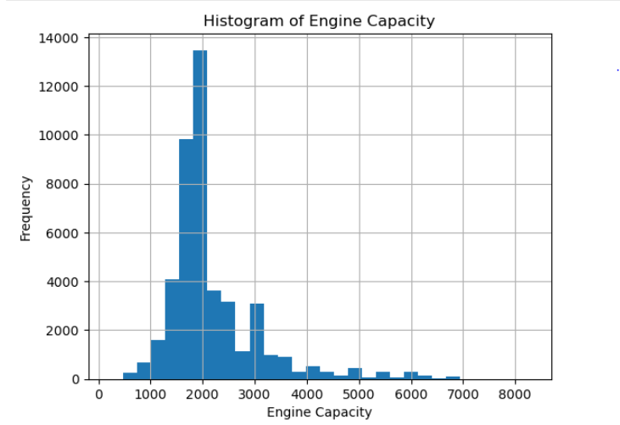
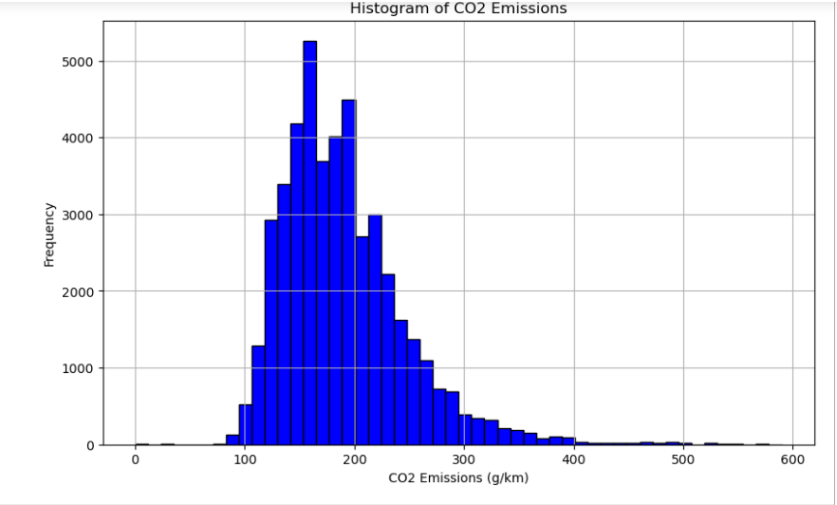
Exploratory Data Analysis
Most vehicles have smaller engines, and fewer vehicles have larger engines
As CO2 emissions increase, the number of vehicles decreases

Slide 16
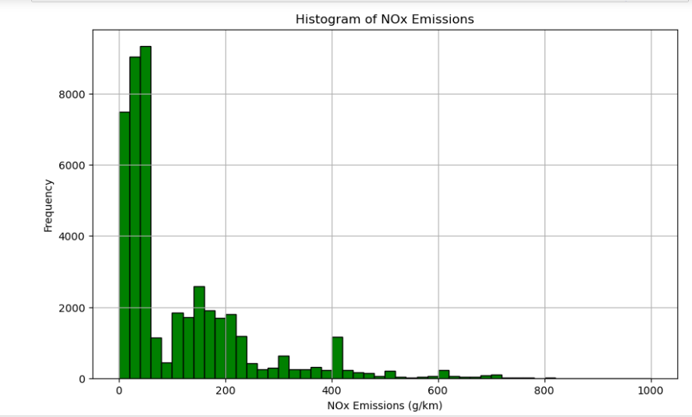
A high frequency of vehicles have low NOx emissions.
As the NOx emissions increase, the frequency of vehicles drastically decreases.
Indicates that higher NOx emissions are much less common in this dataset

Slide 17
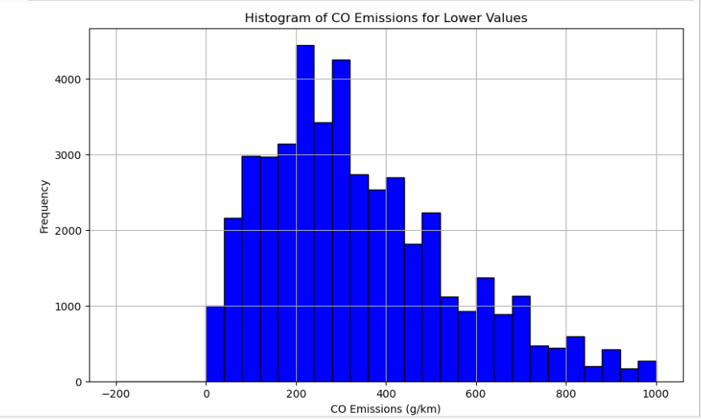
Right skewed-Many vehicles have relatively low CO emissions.

Slide 18
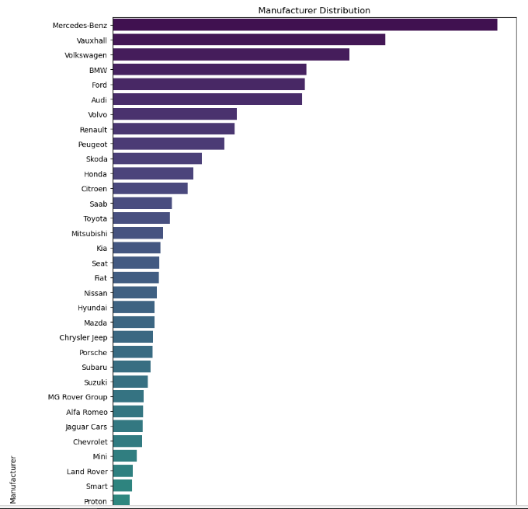
Count of vehicles by different manufacturers.

Slide 19
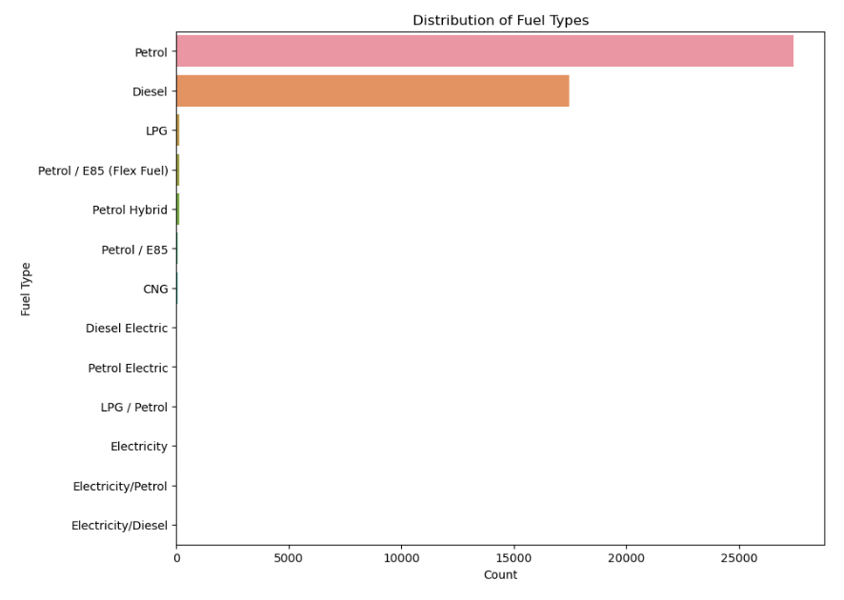
Petrol and Diesel are predominant.

Slide 20
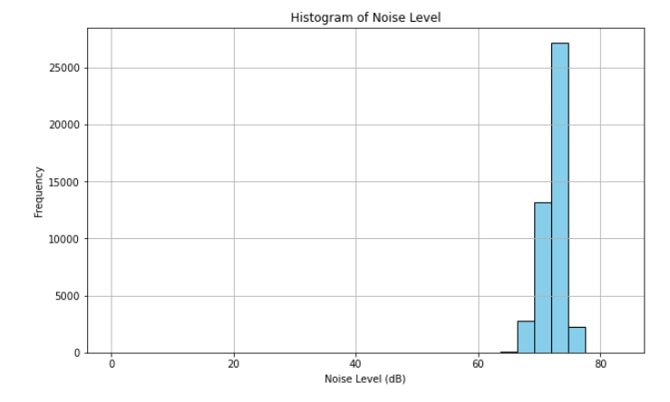
Unimodal-fewer vehicles have lower or higher noise levels compared to the central peak.

Slide 21
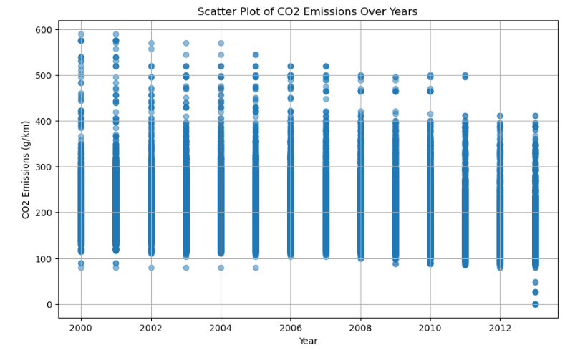
Does not show a clear trend in CO2 emissions reduction or increase over time.

Slide 22
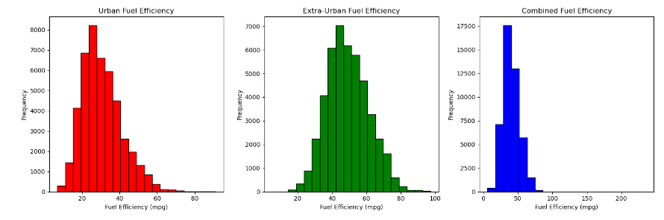
Better overall efficiency but still less than extra-urban driving
Less efficiency
More fuel-efficient

Slide 23
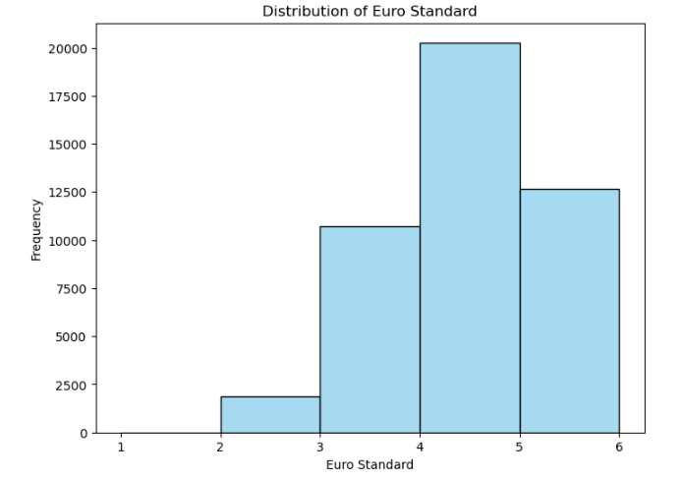
Euro 4 standards were actively enforced.
Euro 1 and Euro 2 -phasing out of older vehicles.
Euro 5 and Euro 6-potentially reflecting the transition.

Slide 24
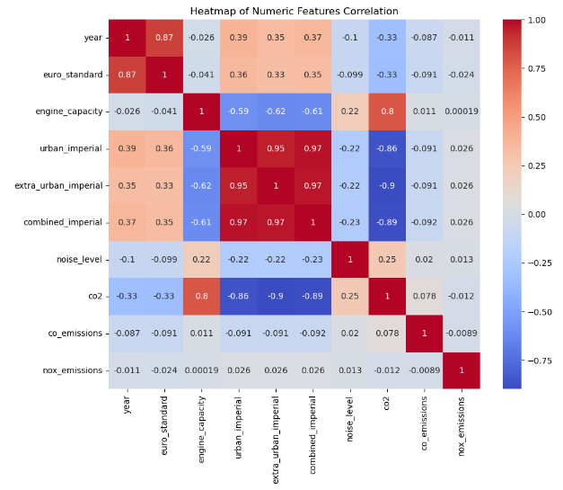

Slide 25
Insights:
Higher fuel efficiency in urban settings tend to also be more efficient in extra-urban and overall conditions.
Newer vehicles tend to comply with more stringent emission standards.
As fuel efficiency improves, CO2 emissions tend to decrease.
'co2' shows 'combined_imperial', 'extra_urban_imperial', and 'urban_imperial' as having the strongest negative correlations.
High multicollinearity, such as ('year', 'euro_standard') and the fuel efficiency metrics-problematic in predictive modeling due to redundancy.

Slide 26
Insights
ear (-0.3274): This negative correlation indicates that newer vehicles (higher 'year') tend to have lower CO2 emissions. This could be due to advancements in technology, more efficient engines, and stricter emission standards in newer models.
Euro Standard (-0.3289): Similar to 'year', the negative correlation here suggests that vehicles conforming to higher Euro standards (which are stricter in terms of emissions) are associated with lower CO2 emissions. This aligns with the objective of these standards to reduce vehicle emissions.
Engine Capacity (0.7974): A strong positive correlation indicates that larger engine capacities are associated with higher CO2 emissions. This is expected, as larger engines typically consume more fuel.

Slide 27
Insights
Noise Level (0.2518): This positive but weaker correlation suggests a mild association between higher noise levels and higher CO2 emissions. This might reflect larger or more powerful engines that both emit more noise and CO2.
Urban Imperial (-0.8614), Extra Urban Imperial (-0.8985), Combined Imperial (-0.8854): These strong negative correlations indicate that higher fuel efficiency (measured in miles per gallon in urban, extra-urban, and combined settings) corresponds to lower CO2 emissions. This is logical as more fuel-efficient vehicles use less fuel for the same distance and thus emit less CO2.
The values indicate that engine capacity and fuel efficiency metrics are particularly strong predictors of CO2 emissions. The 'year' and 'euro_standard' also play significant roles, reflecting changes in vehicle technology and regulations over time.

Slide 28
Machine Learning Models
Logistic Regression
Support Vector Machine
Multinomial Naive Bayes
Decision Trees
Random Forest
Gradient Boost
Stacking classifier

Slide 29
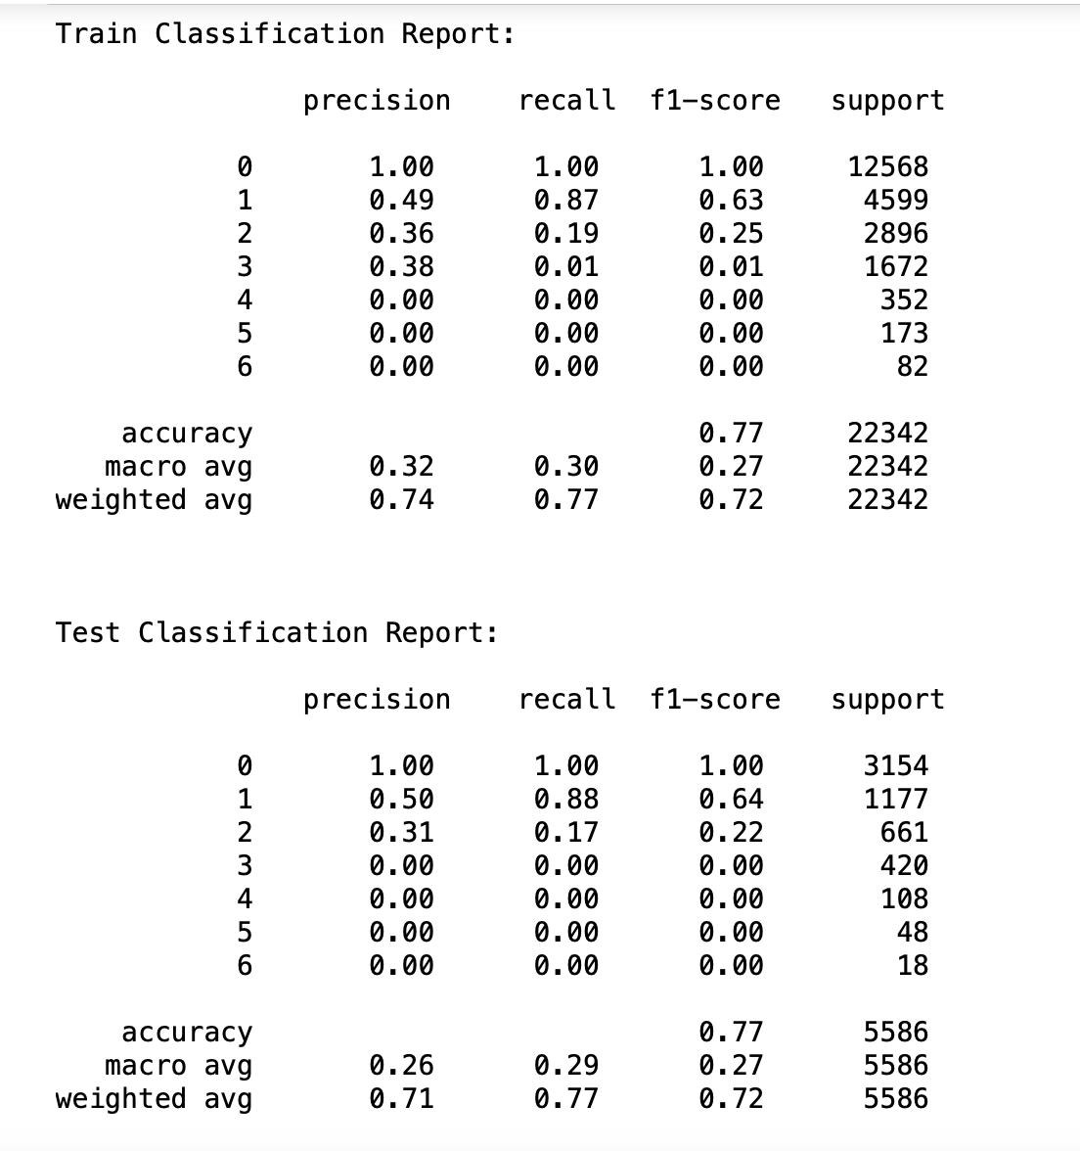
Logistic Regression

Slide 30
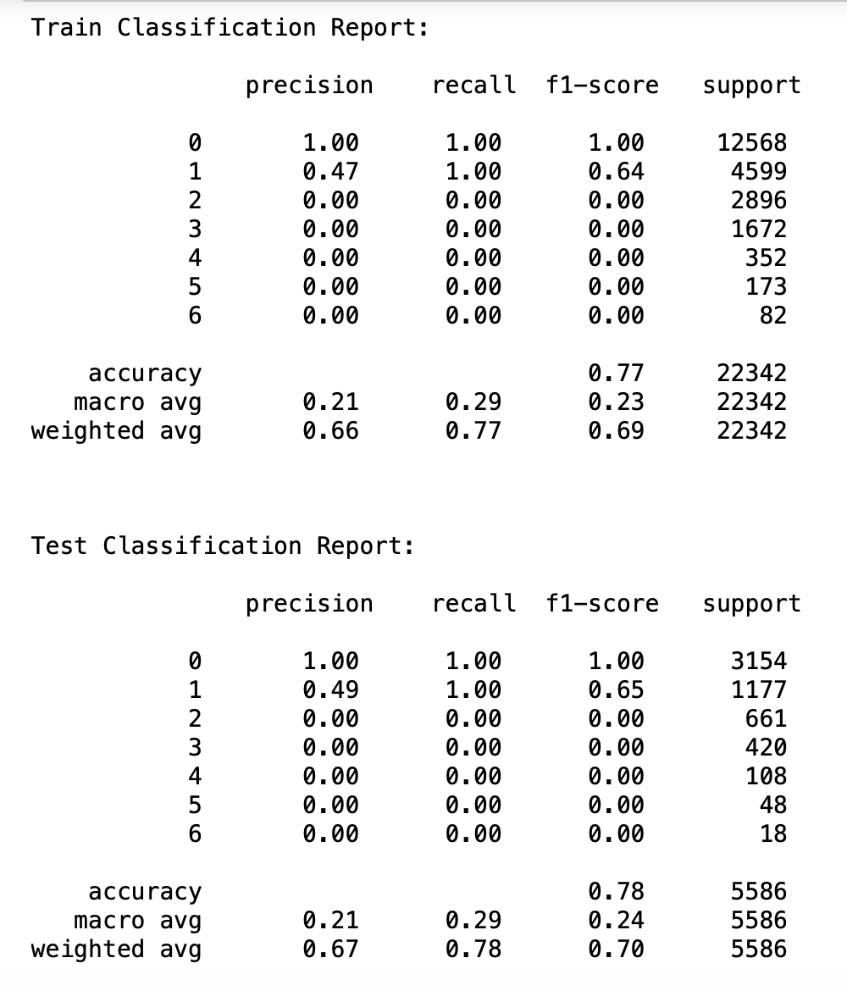
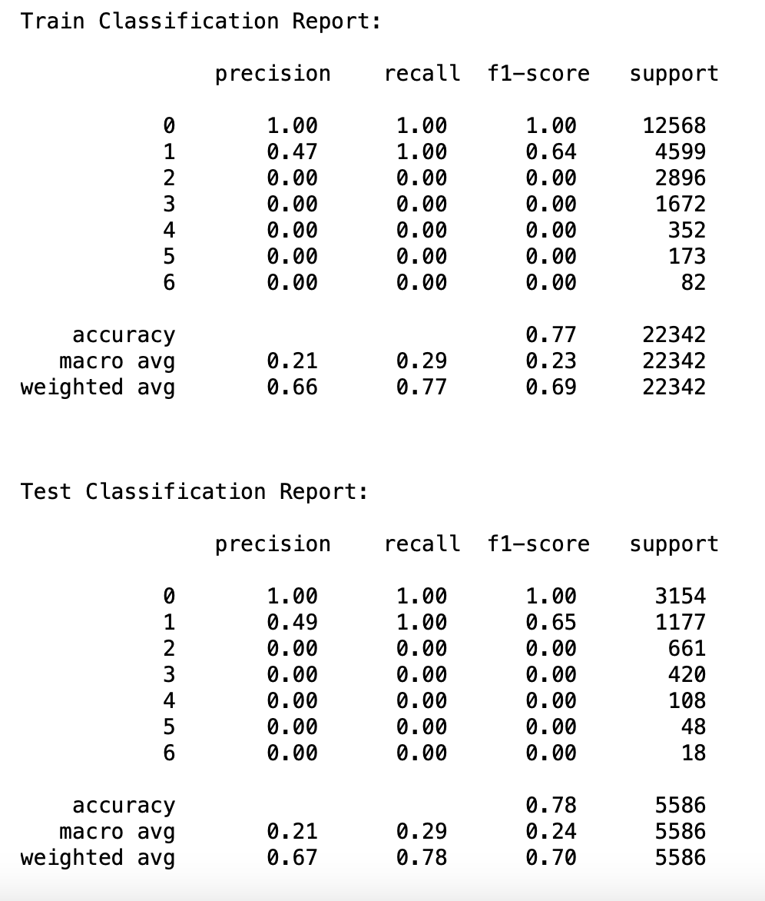
Support Vector Machine
After Hyper parameter tuning

Slide 31
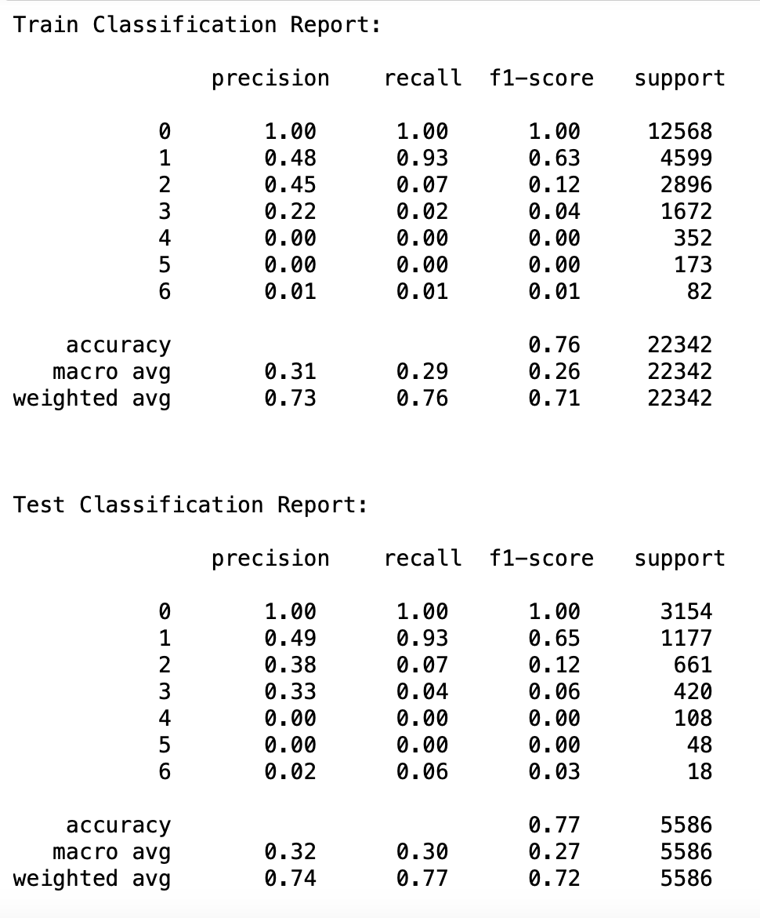
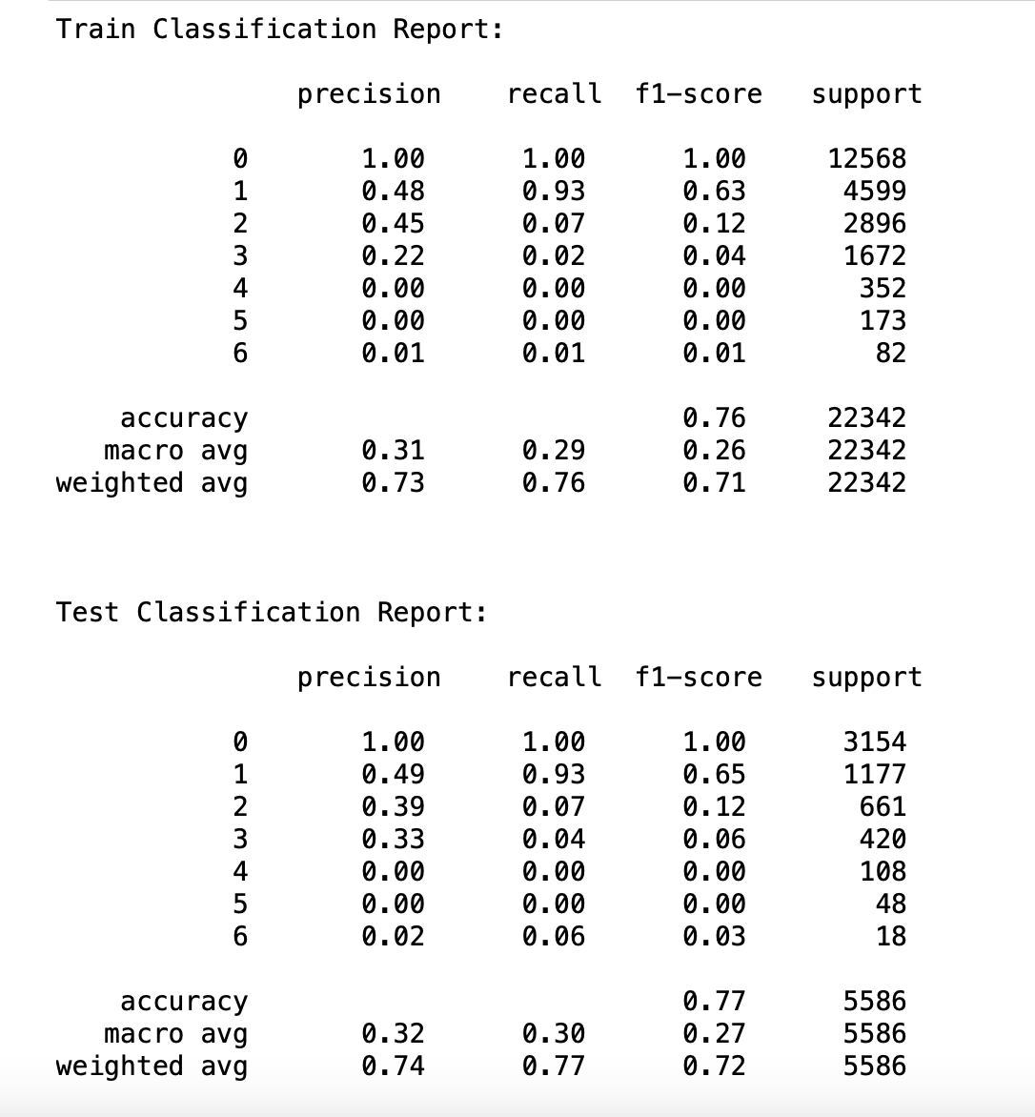
Multinomial Naive Bayes
After Hyper parameter tuning

Slide 32
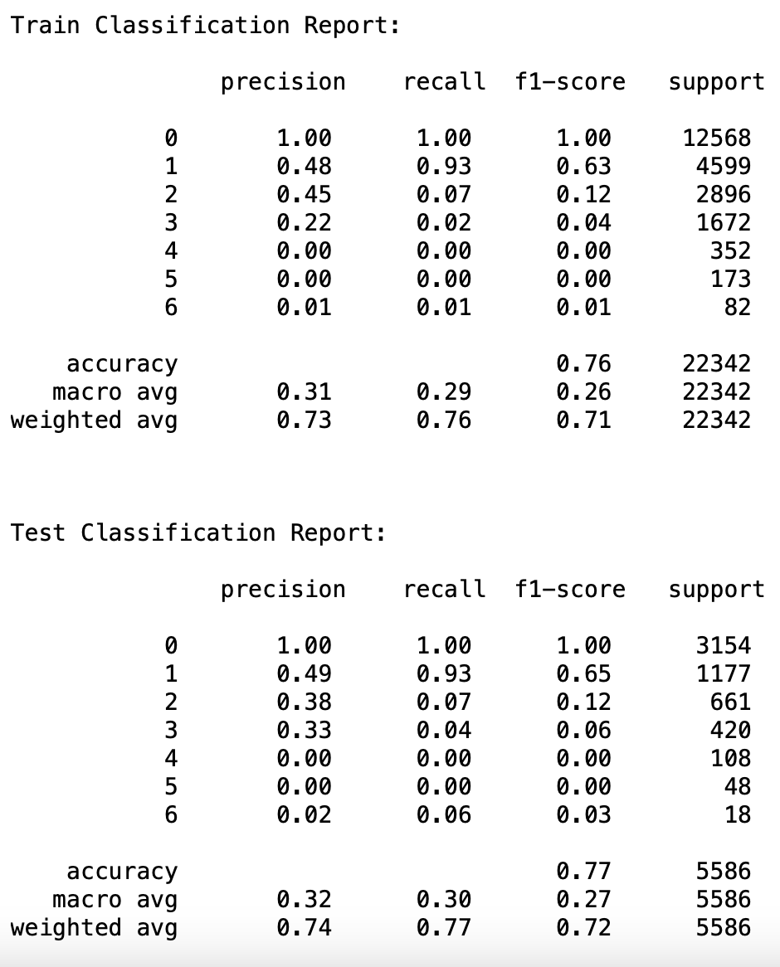
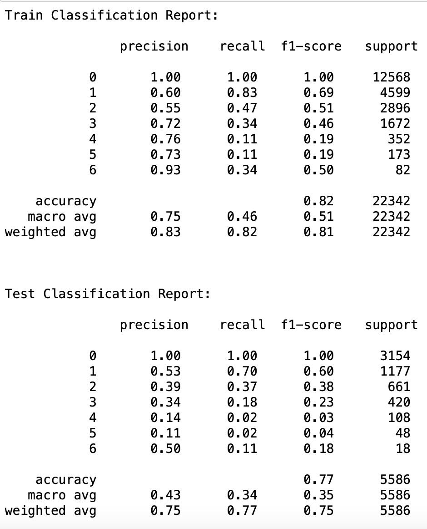
Decision Tree Classifier
After Hyper parameter tuning

Slide 33
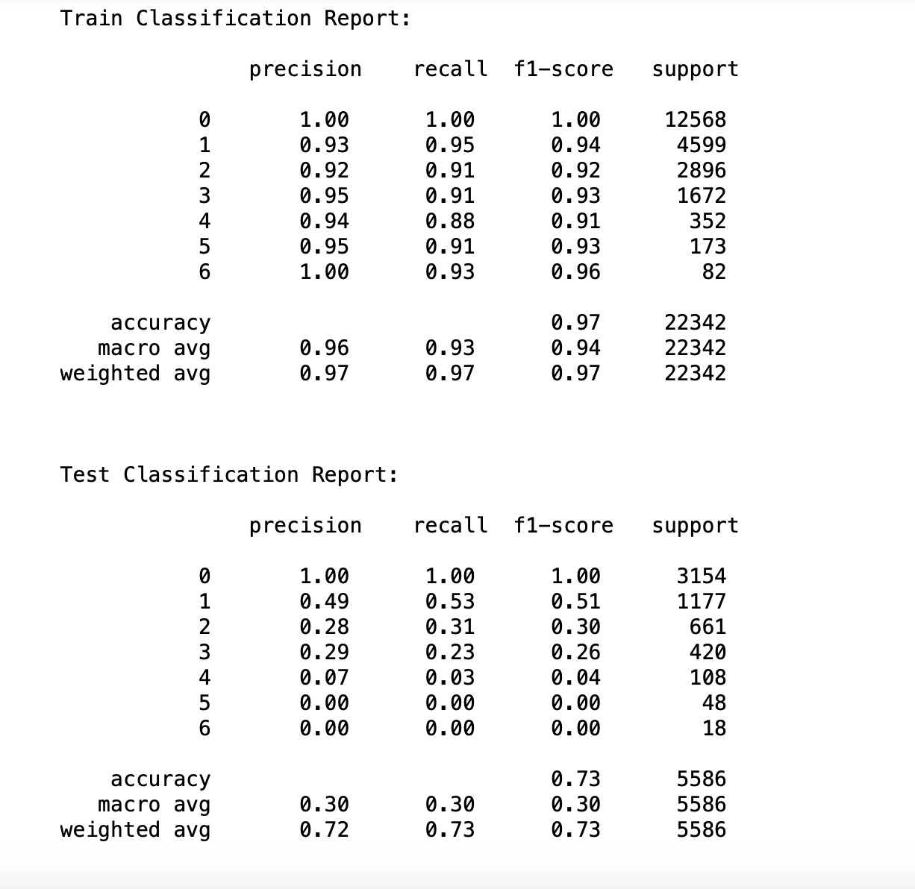
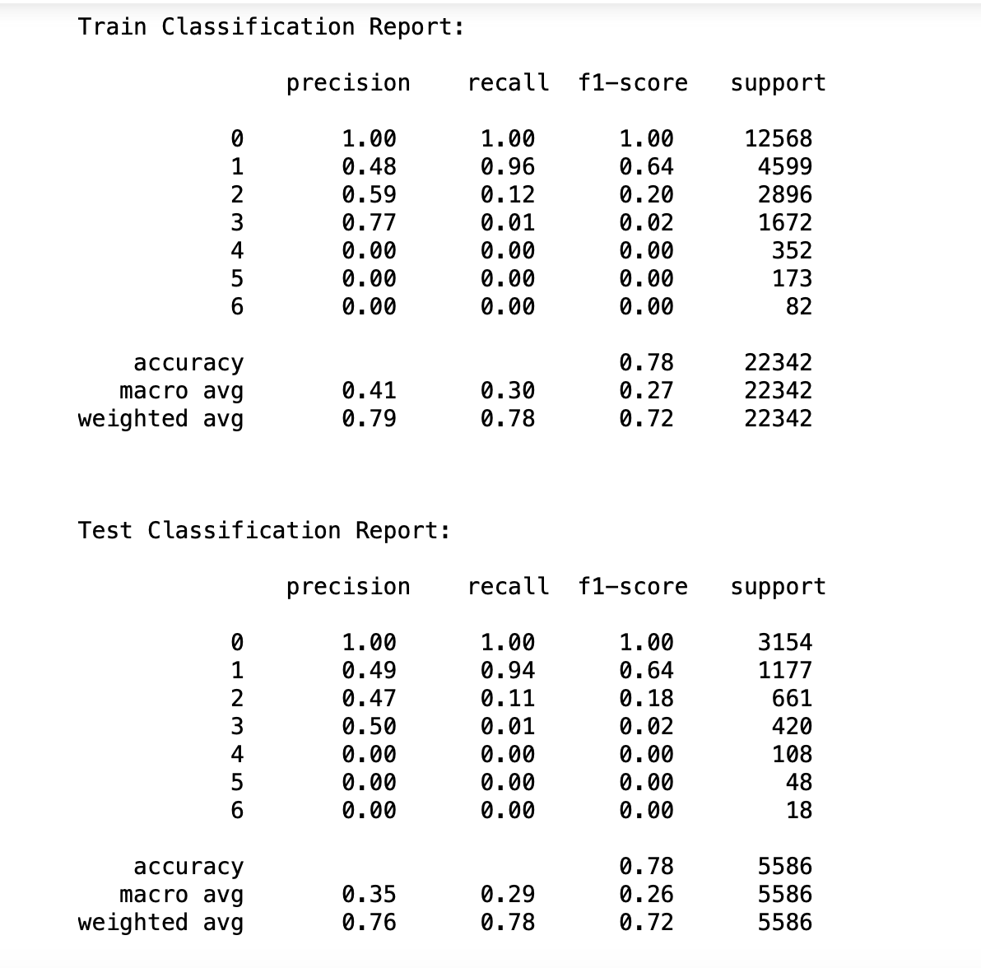
Random Forest Classifier
After Hyper parameter tuning

Slide 34
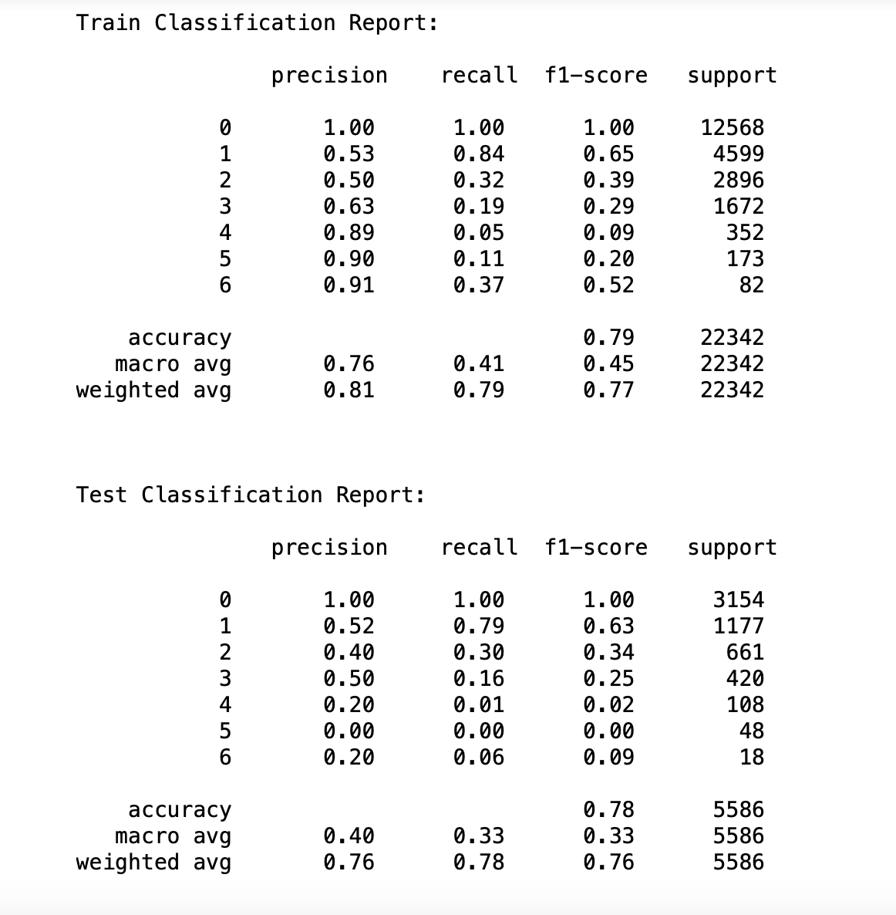
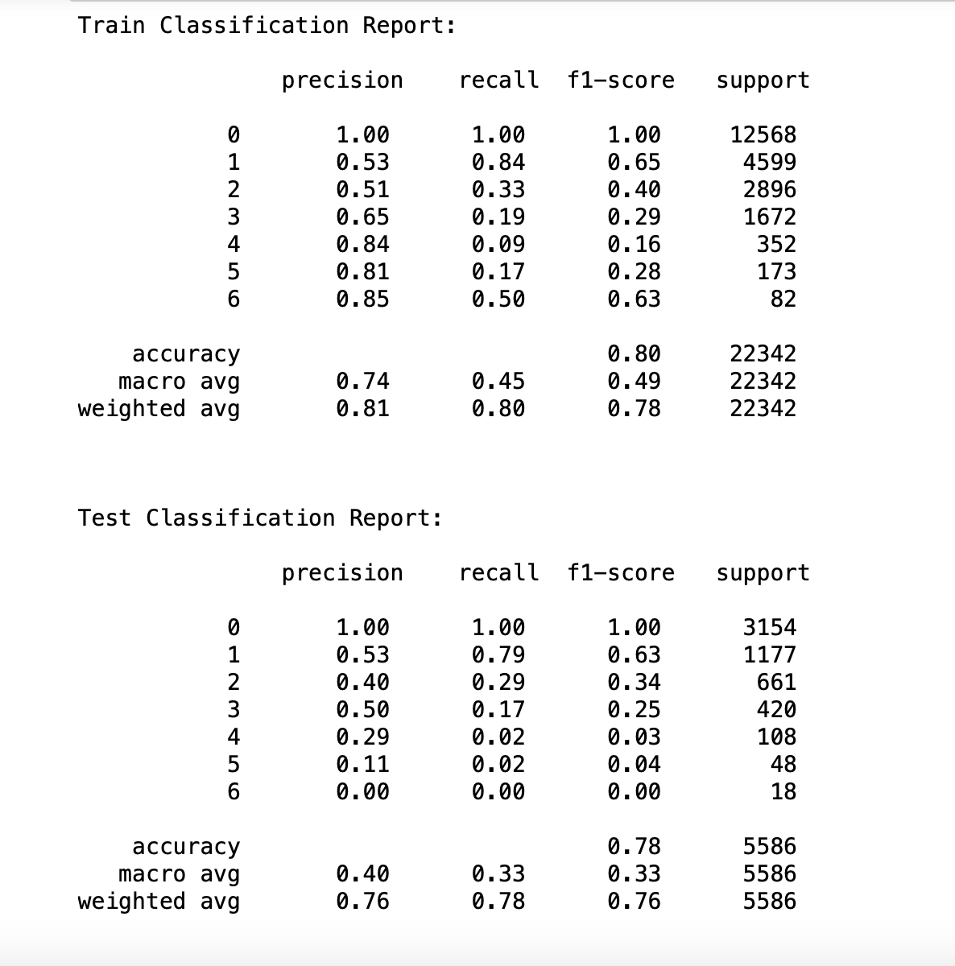
Gradient Boosting Classifier
After Hyper parameter tuning

Slide 35
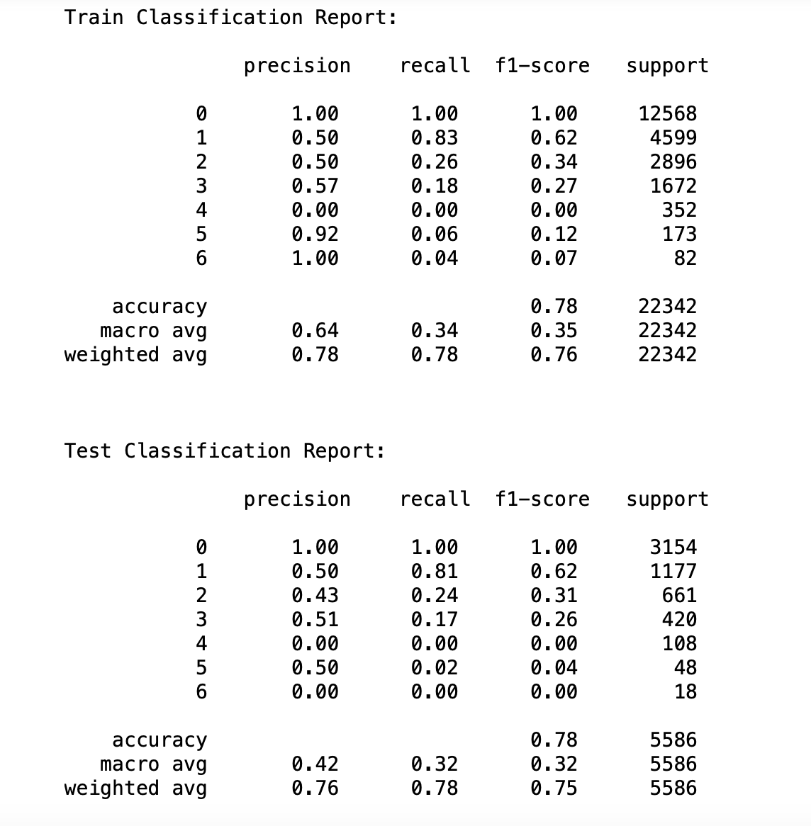
Stacking Classifier

Slide 36
Comparison Table
 | Logistic Regression | SVM | Multinomial Naïve Bayes | Decision Tree | Random Forest | Gradient Boosting | Stacking Classifier
0 | 1.00 | 1.00 | 1.00 | 1.00 | 1.00 | 1.00 | 1.00
1 | 0.64 | 0.65 | 0.65 | 0.60 | 0.64 | 0.63 | 0.62
2 | 0.22 | 0.00 | 0.12 | 0.38 | 0.18 | 0.34 | 0.31
3 | 0.00 | 0.00 | 0.06 | 0.23 | 0.02 | 0.25 | 0.26
4 | 0.00 | 0.00 | 0.00 | 0.03 | 0.00 | 0.03 | 0.00
5 | 0.00 | 0.00 | 0.00 | 0.04 | 0.00 | 0.04 | 0.04
6 | 0.00 | 0.00 | 0.03 | 0.18 | 0.00 | 0.00 | 0.00
Accuracy | 0.77 | 0.78 | 0.77 | 0.77 | 0.78 | 0.78 | 0.78

Slide 37
Conclusion

Slide 38
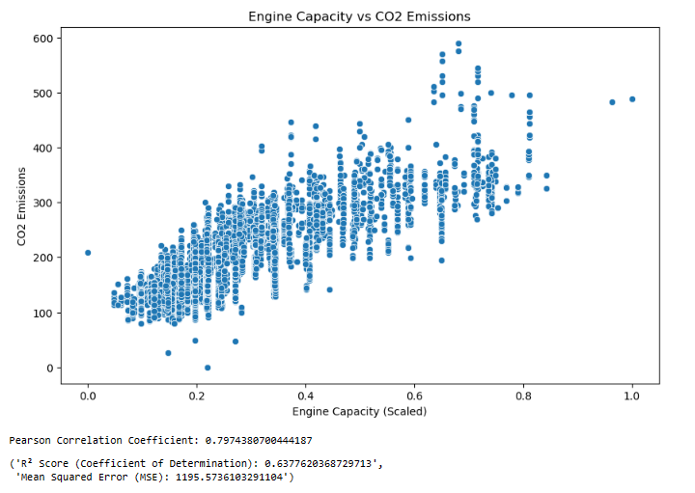
Research Questions:
How does engine capacity correlate with CO emissions, and can a machine learning model effectively predict this relationship?

Slide 39
Can the noise level of a vehicle be predicted based on engine capacity, fuel type, and transmission type?
Difficult to assert that the noise level of a vehicle can be accurately predicted based solely on engine capacity, fuel type, and transmission type, at least not with the models and features used here.

Slide 40
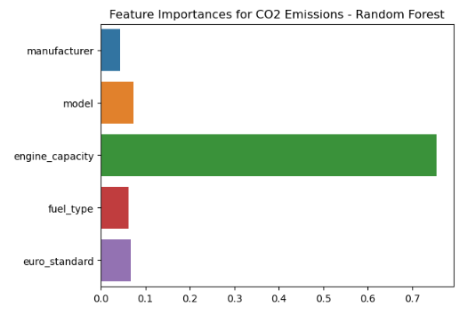
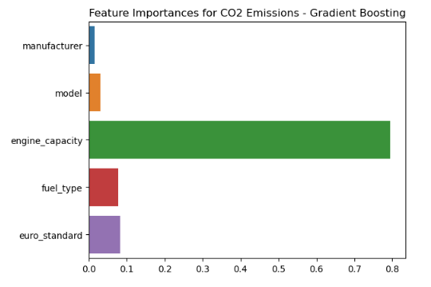
Are certain manufacturers and models more efficient in terms of emissions (CO2, NOx), and can we predict this efficiency based on available vehicle specifications?

Slide 41
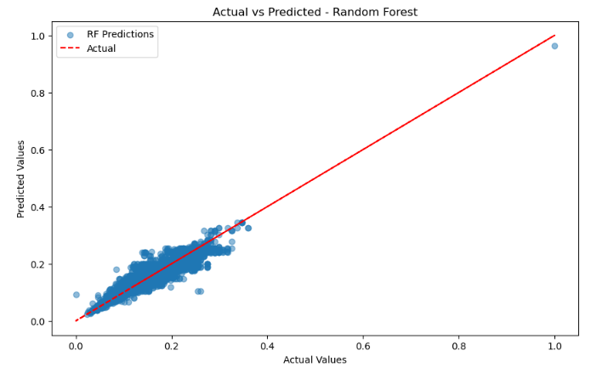
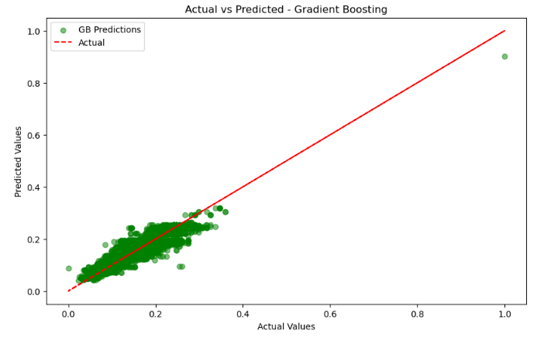
Can engine capacity, transmission type (manual or automatic), and fuel type be used to predict a vehicle's fuel efficiency (e.g., combined_imperial representing combined fuel efficiency)?

Slide 42

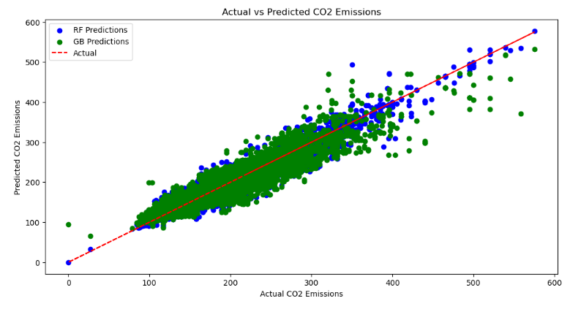
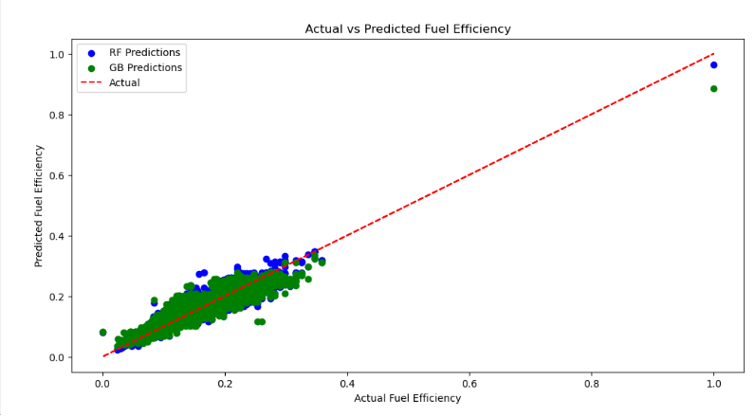
Can we use the model year to predict changes in emissions (CO2, NOx) and fuel efficiency over time for different vehicle models?

